Slide 1
Capital Gains Tax

Slide 2
What is a capital gain (loss)?
If you sell a capital asset, such as real estate or shares, you usually make a capital gain or a capital loss (subject to exceptions).
1) Gain 2) Loss
Sale price $520,000 $300,000
Less: purchase price $300,000 $400,000
Capital gain / loss $220,000 ($100,000)

Slide 3
Who does it apply to?
If you’re an Australian resident, CGT applies to your assets anywhere in the world.
Foreign residents make a capital gain or loss if a CGT event happens to an asset that is 'taxable Australian property.’

Slide 4
Common CGT Assets
Property
Shares
Leases
Goodwill
Personal use assets purchased for more than $10,000
Collectables (such as jewellery, antiques, and artwork)

Slide 5
Question
Are the following CGT assets or personal use assets:
1. An engagement ring which cost $5,000?
Personal use – used or kept for personal use (less than $10K)
2. A second-hand car purchased for $2,000?
Personal use - Gains and losses from cars are exempt
3. Shares in BHP?
CGT asset
4. Your home?
CGT asset (but exempt under main residence exemption)
5. A holiday house at Torquay?
CGT asset

Slide 6
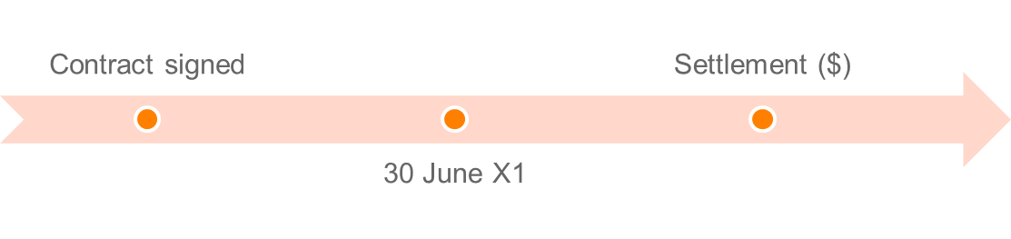
Time of the event
Contract date not settlement date
If you sign a contract to sell an investment property in June 2019, and settle in August 2019, you need to report the capital gain or loss in your 2018–19 tax return.
Pre CGT Exemption:
On or before 20 September 1985 = CGT exempt
After 20 September 1985 = Subject to CGT (unless otherwise excluded)

Slide 7
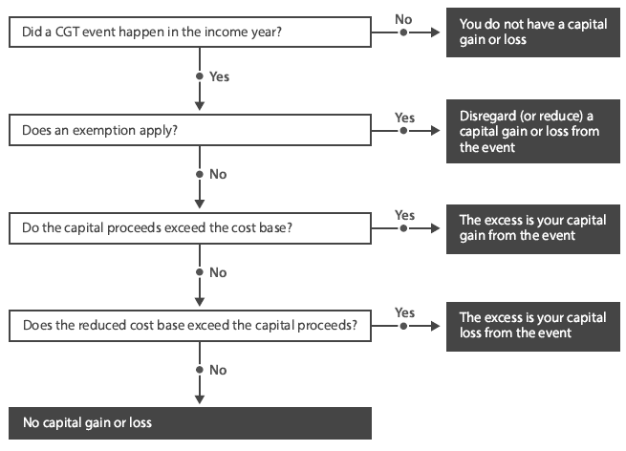
Methodology
Source: CA Program Study Guide– Tax: Unit 4

Slide 8
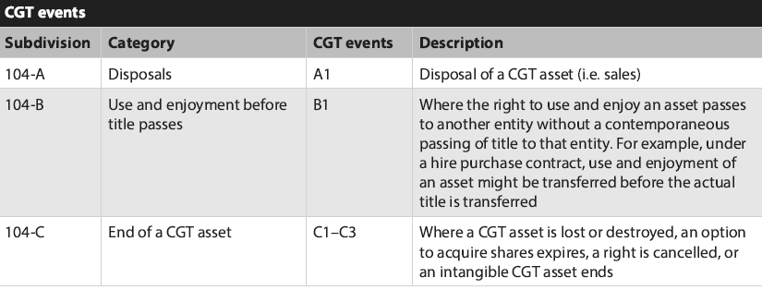
CGT Events

Slide 9
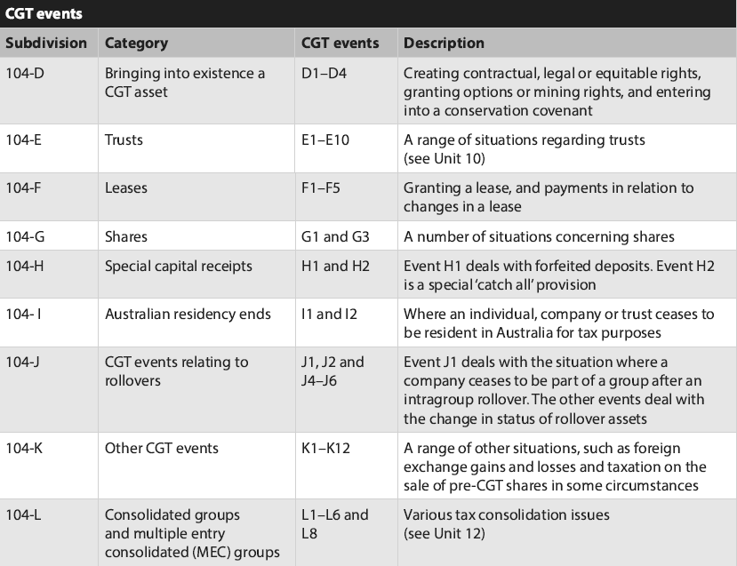
Source: CA Program Study Guide– Tax: Unit 4

Slide 10
Cost base elements
Element 1: Money or value of property given for acquisition
Money paid (or required to be paid) for the asset and the market value of property given (or required to be given) to acquire the asset.
Element 2: Incidental costs related to acquisition or disposal
Remuneration for legal advisor, accountant, valuer or auctioneer
Cost of transfer
Stamp duties
Marketing and advertising
Valuations
Search fees
Conveyancing
Borrowing expenses (not apportioned)
Termination or exit fees

Slide 11
Cost base elements
Element 3: Costs of ownership
You don't include these costs if you acquired the asset before 21 August 1991.
The costs of owning an asset include rates, land taxes, repairs and insurance premiums. You also include any non-deductible interest on loans used to finance:
The acquisition of a CGT asset
Capital expenditure to increase an asset’s value.
You can’t:
Include these costs in the cost base of collectables or personal use assets
Index these costs
Use them to work out a capital loss.

Slide 12
Cost base elements
Element 4: Capital expenses relating to the asset
Expense to increase or preserve asset’s value
Expense to install or move the asset
Does not include costs related to goodwill
E.g. Expenses for renovating a house would fall under this element
Element 5: Capital expenses relating to title/ ownership of the asset
Preserving the assets title
May arise where you litigate to reinforce your title.
  E.g. Litigation regarding adverse possession or land boundary disputes

Slide 13
Scenario
Frank has recently sold his beach house at Lorne. The beach house was acquired on 1 July 2015 for $600,000 and rented to tenants for the first two years.
From 1 July 2017 to the date of sale (30 June 2019), the property was used solely by Frank and his family for private use.
Frank has asked you to calculate the capital gain or loss on the sale of the beach house.

Slide 14
Scenario
What cost base elements do the below examples fall into:
1. Purchase price: $600,000?
Element 1: Money given for acquisition
2. Stamp duty paid to the Victorian Government: $80,000?
Element 2: Incidental costs related to acquisition or disposal
3. Repairs (which were not expensed): $6,600?
Element 4: Capital expenses relating to the asset
4. Legal fees relating to 2018 boundary dispute with neighbour: $4,000?
Element 5: Capital expenses relating to title/ ownership of the asset
5. Land tax: $6,000 (deducted in 2017 tax return)?
Does not form part of the cost base
6. Agent’s commission: $30,000?
Element 2: Incidental costs related to acquisition or disposal
7. Fine imposed by Surf Coast Shire for erecting illegal ‘For Sale’ signs (breach of Local Government Act 1989): $300?
Does not form part of the cost base

Slide 15
Modifications to capital gains
Market value substitution rule
Apportionment rule
Non-receipt rule
Repaid rule
Assumption of liability rule
Misappropriation rule

Slide 16
1. “Market value” Modification
Applies when the taxpayer:
  Receives no capital proceeds;
  Some or all capital proceeds cannot be valued; or
  Did not deal at ‘arm’s length’ with the other entity.
Capital proceeds are deemed to be the market value.
‘Arms-length’: an unrealistic value for purchase normally because of the relationship (e.g. Candice sold me her house for $10 because we’re friends).
Would the reasonable person consider the sale at arm’s length?

Slide 17
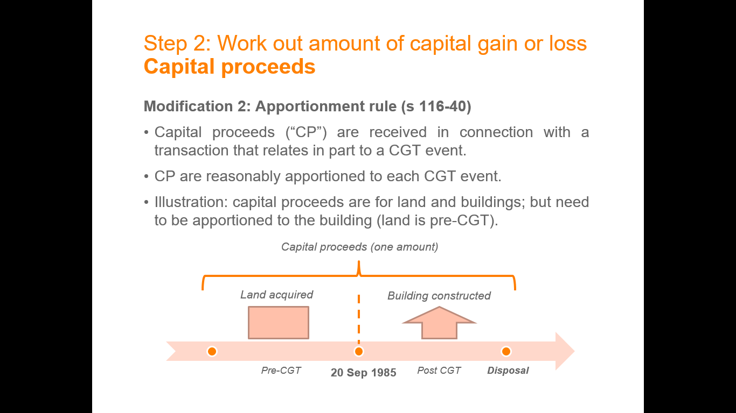
2. Apportionment Modification
When a single proceed is the total of two or more events, the proceeds must be apportioned between those events.
E.g. A lump sum of $800,000 for the sale of house and a yacht, these will need to be apportioned to determine the value of each

Slide 18
3. Non-receipt Rule
Allows the Capital Proceeds to be reduced by any amount that you have not received and will not receive after all reasonable attempts have been made to get it.
Capital proceeds are reduced to the extent the taxpayer has to repay capital proceeds already received.
4. Repaid Rule

Slide 19
5. Assumption of Liability Rule
Capital proceeds are increased if another entity assumes liability in connection with the CGT event. (I.e. pay you $100k plus take over mortgage for $100k).
E.g. John sells apartment for $250,000 and purchaser took over $50,000 debt = capital proceeds will be $300,000
Allows you to reduce capital proceeds by any amount misappropriated by an employee or agent.
E.g. Real estate agent takes the 10% deposit from a house sale, this 10% will be deducted
6. Misappropriation Rule

Slide 20
Exempt Assets
Cars and motorcycles - (s 118-5)
Personal use assets - (s 109-20)
Assets used to produce exempt income - (s 118-12(1))
Shares in a pooled development fund - (s 118-13)
Investments made in start-up companies - (Subdiv 360-A)
Depreciating assets - (s 118-24(1))
Trading stock - (s 118-25)
Personal compensation – (s 118-37(1)(a) & (b))
      Personal wrong, injury or illness
Private lease ending – (s 118-40)
Gambling and competitions with prizes – (s 118-37(1)(c))

Slide 21
Exemptions
Main residence exemption;
50% discount (if held for 12 months or more);
15-year exemption;
50% active asset exemption;
Retirement exemption; and
Rollover; and
  Small business restructure rollover (accessible for businesses with 10M or less turnover);
SBE Concessions

Slide 22
Main residence exemption
Any capital gain or capital loss that an individual taxpayer makes from a CGT event happening in relation to a dwelling (or interest in a dwelling) that is the person’s main residence is disregarded.
A dwelling includes a unit of accommodation that is:
a building or is contained in a building, and consists wholly or mainly of residential accommodation; and
a caravan, houseboat or other mobile home,
and any land immediately under the unit of accommodation (s 118-115).
The MRE applies only where an individual or individuals make the capital gain. For example, the exemption cannot apply to a residence that is owned by a family trust even if the family occupies it as their main residence.

Slide 23
Main residence exemption
Adjacent land
Where a CGT event also happens to land adjacent to a dwelling (or part of the dwelling), that is also used primarily for private or domestic purposes, the exemption will apply to a total of two hectares of land. That includes the land on which the dwelling is built. A taxpayer can choose the two hectares to which the MRE applies. Refer to TD 1999/67 for examples.

Slide 24
Changing main residences
Where a taxpayer acquires a dwelling that is to become a main residence, and already has a main residence, both residences can benefit from the exemption for the shorter of:
six months (ending when the CGT event happened to the existing residence); or
the period from the acquisition of the new residence to the CGT event happening to the existing residence.
However, this exemption is only available if the existing main residence was the main residence for at least three months in the 12 months prior to the CGT event, and provided that it was not used to produce assessable income in that 12-month period when it was not the main residence.

Slide 25
Basic Conditions for Small Business CGT Concessions
Step 1: You must satisfy one for the following:
You're a small business entity with an aggregated turnover of less than $2 million
You don't carry on business (other than as a partner) but your CGT asset is used in a business carried on by a small business entity that is your affiliate or an entity connected with you (passively-held assets)
You're a partner in a partnership that is a small business entity, and the CGT asset is either -
  an interest in a partnership asset (partnership assets)
  an asset you own that is not an interest in a partnership asset (partner's assets) but is used in the business of the partnership
You satisfy the maximum net asset value test (<$6M net assets for assets owned by you and certain affiliates).

Slide 26
Basic Conditions for Small Business CGT Concessions
Step 2: Active asset test. A CGT asset is an active asset if:
You own it.
You use it or hold it ready for use in the course of carrying on a business (whether alone or in partnership)
It is an intangible asset (for example, goodwill) inherently connected with a business you carry on (whether alone or in partnership).
The asset was owned for a total of at least 7½ years during the test period, if you've owned it for more than 15 years, or for at least half of the test period, if you've owned it for 15 years or less.
The asset does not need to be an active asset just before the CGT event.

Slide 27
Basic Conditions for Small Business CGT Concessions
Active asset test – Example
Jodie ran a florist business from a shop she owned for eight years. She ran the business for five years, and then leased it to an unrelated party for three years before selling. The shop satisfies the active asset test because it was actively used in Jodie’s business for more than half the period of ownership, even though the property was not used in the business just before it was disposed of.

Slide 28
Small Business 15-year Exemption
You can entirely disregard the capital gain and don't need to apply any other concessions if:
It is an active asset
You continuously owned the asset for the 15-year period just before the CGT event
Conditions for individuals:
You were permanently incapacitated, or
At least 55 years old and the event happened in connection with your retirement

Slide 29
Small Business 15-year Exemption
Conditions for companies and trusts:
You had a significant individual for a total of at least 15 years of the whole period of ownership (even if it was not the same significant individual during the whole period), and
The individual who was a significant individual just before the CGT event was:
  At least 55 years old at that time and the event happened in connection with their retirement, or
  Permanently incapacitated at that time.

Slide 30
Small Business 50% Active Asset Reduction
You can reduce the capital gain on an active asset by 50% (in addition to the 50% CGT discount if you've owned it for 12 months or more).
To apply the small business 50% active asset reduction, you need to satisfy only the basic conditions discussed previously. There are no further requirements.
Can choose for it not to apply.

Slide 31
Small Business Retirement Exemption
You may choose to disregard all or part of a capital gain under the small business retirement exemption if you satisfy certain conditions.
If you're an individual who chooses the retirement exemption, you don't need to terminate any activity or cease business.
You may apply this small business rollover concession:
After firstly using the small business 50% active asset reduction (if you choose to apply it), and then the 50% CGT discount (if applicable), or
After you've applied any capital losses and CGT discount (if applicable)

Slide 32
Small Business Retirement Exemption
Conditions for individuals:
You can choose to disregard all or part of a capital gain if:
You satisfy the basic conditions for the small business CGT concessions (mentioned earlier)
You keep a written record of the amount you chose to disregard (the CGT exempt amount), and
If you're under 55 years old just before you choose to use the retirement exemption, you make a personal contribution equal to the exempt amount to a complying super fund
  You are not required to make the contribution until your tax return is lodged. Accordingly, you may use the capital proceeds for other purposes before lodging the return. However, once it is lodged, you must immediately make a contribution of an amount equal to the exempt amount.

Slide 33
Small Business Retirement Exemption
Conditions for companies and trusts:
You can choose to disregard all or part of a capital gain if:
You satisfy the basic conditions
You satisfy the significant individual test (as mentioned earlier)
You keep a written record of the amount you choose to disregard (the exempt amount) and, if there is more than one CGT concession stakeholder, each stakeholder’s percentage of the exempt amount (one may be nil, but together they must add up to 100%)
You make a payment to at least one of your CGT concession stakeholders worked out by reference to each individual’s percentage of the exempt amount
The payment is equal to the exempt amount or the amount of capital proceeds, whichever is less
Payment is made by the later of
  seven days after you choose to disregard the capital gain
  seven days after you receive the capital proceeds from the CGT event.

Slide 34
Small Business Rollover
The small business rollover allows you to defer all or part of a capital gain made from a CGT event happening to an active asset.
You may apply this small business rollover concession:
After firstly using the small business 50% active asset reduction (if you choose to apply it), and then the 50% CGT discount (if applicable), or
After you've applied any capital losses and CGT discount (if applicable)
If you choose the rollover, the capital gain will not be included in your assessable income.

Slide 35
Small Business Rollover
Conditions:
To qualify for the small business rollover, you need to satisfy the basic conditions for the small business CGT concessions.
You can choose to obtain a rollover even if you haven't yet acquired a replacement asset or incurred expenditure on a capital improvement to an existing asset.

Slide 36
Small Business Rollover
What happens after you elect to rollover?
You need to acquire a replacement asset or make capital improvements to existing assets within the replacement asset period.
This period starts one year before the last CGT event in the income year for which you obtained the rollover and ends at the later of:
two years after that last CGT event
six months after the latest time a possible financial benefit becomes or could become due under a look-through earnout right relating to the CGT asset and the disposal.

Slide 37
Small Business Rollover
Further CGT events will happen, and a capital gain will arise, if:
You don't acquire the replacement assets or make capital improvements to existing assets within the replacement asset period, or the assets are not active assets at the end of that period (CGT event J5). The time of the CGT event is at the end of the replacement period.
The rollover amount is greater than your expenditure on the replacement asset or capital improved asset (CGT event J6)
After the end of the replacement asset period, there's a change in the status of a replacement or capital improved asset you chose for the small business rollover (CGT event J2). E.g. You dispose of the replacement asset or you stop using it ready for use in your business. The timing of this CGT event is when the change happens.

Slide 38
Small Business Rollover
Example:
In September 2014, Jacquie made a capital gain of $80,000 on an active asset and met the maximum net asset value test. Jacquie disregarded the whole capital gain under the small business rollover.
In September 2016 (the end of the two-year period), Jacquie did not have any replacement or capital improved assets. CGT event J5 happens and Jacquie makes a capital gain of $80,000 in September 2016.

Slide 39
Small Business Restructure Rollover
This rollover allows small businesses to transfer active assets from one entity (the transferor) to one or more other entities (transferees), on or after 1 July 2016, without incurring an income tax liability.
This applies to the transfer of active assets that are capital gains tax (CGT) assets, trading stock, revenue assets or depreciating assets.
You can access this concession if your aggregated turnover is less than $10 million. There must be no change in ultimate economic ownership of transferred assets.

Slide 40
Small Business Restructure Rollover
Eligible entities
The rollover applies if each party to the transfer is one of the following in the income year in which the transfer occurs:
A small business entity
An entity that has an affiliate that is a small business entity
An entity that is connected with a small business entity
A partner in a partnership that is a small business entity.

Slide 41
Small Business Restructure Rollover
Example:
Amy, Joanna and Remy run a delivery business as equal partners and want to transfer their interests in the assets of the partnership to a company. Joanna and Remy are a couple.
Amy, Joanna and Remy establish a company, whereby 300 identical shares are issued:
100 shares are issued to Amy
150 shares are issued to Joanna
50 shares are issued to Remy.
This is because Remy has other income and Joanna and Remy, as a couple, want to lower their overall income tax bill.
While this doesn’t change the individuals who have the ultimate economic ownership of the asset, there is a change in the proportionate share of that ultimate economic ownership. Accordingly, Amy, Joanna and Remy cannot use the small business restructure rollover.
However, if the shares were distributed equally between the partners, the ultimate economic ownership of the assets would be unchanged, and Amy, Joanna and Remy could use the rollover, subject to satisfying the other conditions.

Slide 42
Small Business Restructure Rollover
Example:
Amy, Joanna and Remy run a delivery business as equal partners and want to transfer their interests in the assets of the partnership to a company. Joanna and Remy are a couple.
Amy, Joanna and Remy establish a company, whereby 300 identical shares are issued:
100 shares are issued to Amy
150 shares are issued to Joanna
50 shares are issued to Remy.
This is because Remy has other income and Joanna and Remy, as a couple, want to lower their overall income tax bill.
While this doesn’t change the individuals who have the ultimate economic ownership of the asset, there is a change in the proportionate share of that ultimate economic ownership. Accordingly, Amy, Joanna and Remy cannot use the small business restructure rollover.
However, if the shares were distributed equally between the partners, the ultimate economic ownership of the assets would be unchanged, and Amy, Joanna and Remy could use the rollover, subject to satisfying the other conditions.

Slide 43
Scrip-for-scrip (Takeovers and Mergers)
If a company in which you own shares is taken over or merges with another company, you may have a capital gains tax (CGT) obligation.
When a company launches a takeover bid by buying shares in the market, they offer money in return for shares. If a company launches an off-market takeover bid, they don’t always offer cash in return for shares – they can either offer money or scrip (shares), or a combination of these.
When you receive shares, you may be able to defer paying capital gains tax until a later CGT event happens (however the cost base will carry forward from the original company’s shares).
You can choose not to apply this rollover. The rollover does not apply where a capital loss would arise.

Slide 44
Indexation - Eligibility
A capital gains tax (CGT) event happened to an asset you acquired before 11.45am (EST) on 21 September 1999; and
You owned the asset for 12 months or more.
If you're a company and the capital gain meets the above conditions, you must use the indexation method to calculate the capital gain.

Slide 45
Record keeping
What needs to be recorded:
All transactions effecting CGT events
Date of acquisition and disposal
Each cost base element
Consideration on disposal
Parties to the transaction
Retain records for 5 years after disposal

